Slide 1
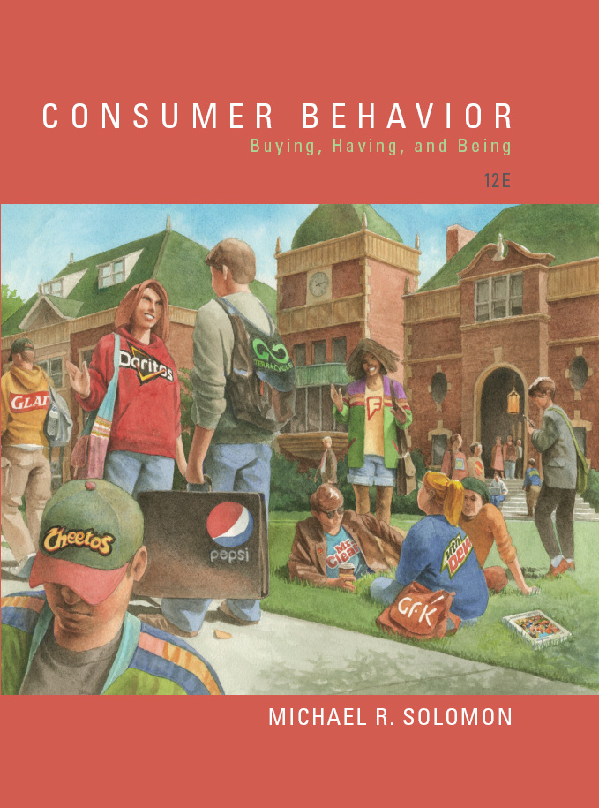
Consumer Behavior: Buying, Having, and Being
Twelfth Edition
Chapter 13
Subcultures
Copyright © 2017, 2015, 2013 Pearson Education, Inc. All Rights Reserved.
Notes:
If this PowerPoint presentation contains mathematical equations, you may need to check that your computer has the following installed:
1) MathType Plugin
2) Math Player (free versions available)
3) NVDA Reader (free versions available)
This chapter defines the scope of international business and introduces us to some of its most important topics.

Slide 2
Learning Objectives (1 of 2)
13.1 Consumer identity derives from “we” as well as “I”.
13.2 Our memberships in ethnic, racial, and religious subcultures often play a big role in guiding our consumption behaviors.
13.3 Marketers increasingly use religious and spiritual themes when they talk to consumers.
13.4 Our traditional notions about families are outdated.
13.5 We have many things in common with others because they are about the same age.

Slide 3
Learning Objectives (2 of 2)
13.6 Teens are an important age segment for marketers.
13.7 Baby Boomers are the most economically powerful age segment.
13.8 Seniors are a more important market segment than many marketers realize.
13.9 Birds of a feather flock together in place-based subcultures.

Slide 4
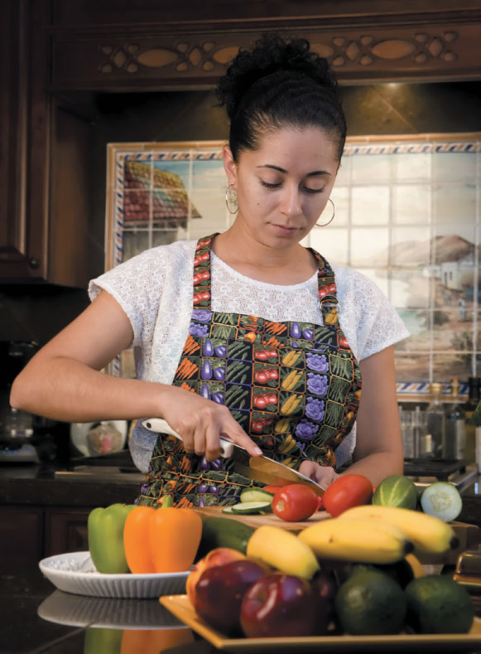
Learning Objective 13.1
Consumer identity derives from “we” as well as “I”.
Notes:
Maria, who is pictured in the slide, lives in Los Angeles, not Mexico City, as you might have guessed. More than one in four Californians are Hispanic and overall the state has more nonwhite than white residents. Maria is an example of how people can build their self identity on the basis of many subcultures. We will cover several of these subcultures in this chapter.

Slide 5
Subcultures
Social identity is that part of the self that our group memberships define.
The categories that matter in establishing our consumer identity are subcultures.
Notes:
Our group memberships within our society-at-large help to define us. A subculture is a group whose members share beliefs and common experiences that set them apart from others. We all belong to many subcultures, depending on our age, race, ethnic background, and place of residence.
People who are part of a microculture freely identify with a lifestyle or aesthetic preference.

Slide 6
The Context of Culture
High-Context
Low-Context
Notes:
An important subcultural difference is how abstract or literal a group is. Sociologists make a distinction between high-context cultures and low-context cultures. In a high-context culture, group members are tightly knit and they infer meanings that go beyond the spoken word. Symbols and gestures are used instead of words to carry the weight of the message. In contrast, people in a low-context culture are more literal. Compared to Anglos, many minority cultures are high-context and have strong oral traditions. This means that consumers are more sensitive to nuances in advertising.

Slide 7
What is Acculturation?
Acculturation occurs, at least in part, with the influence of acculturation agents.
Family
Friends
Church organizations
Media
Notes:
Acculturation is the process of movement and adaptation to one country’s cultural environment by a person from another country. Acculturation agents are the influences in our environment which affect the process of transitioning from one culture to another that contains components of both the old and new culture. These agents are family and friends, as well as organizations like churches, and even the media. The agents may be from the culture of origin or from the culture of immigration.

Slide 8
The Progressive Learning Model
Assumes that people gradually learn a new culture as they increasingly come into contact with it
When people acculturate they will blend their original culture and the new one
Consumers who retain much of their original ethnic identity differ from those who assimilate

Slide 9
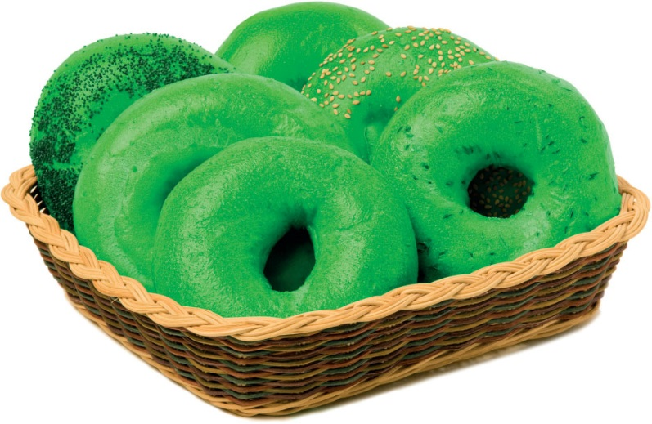
Is Ethnicity a Moving Target?
Defining/targeting an ethnic group is not always so easy (“melting pot” society)
Deethnicization occurs when a product we associate with a specific ethnic group detaches itself from its roots and appeals to other groups
Notes:
Some people feel uncomfortable with the notion that marketers should explicitly take into account people’s racial and ethnic differences when they formulate strategies. Still, we must because ethnicity affects consumers’ behaviors.
Targeting using such characteristics can be challenging. It’s not always easy to define members of a distinct group and in our society, many people are members of multiple groups.
Products that companies market for one ethnic group sometimes gain appeal with others outside the subculture. This is known as deethnicization. There are many food products that are examples of deethnicization, such as bagels.

Slide 10
African Americans
Overall spending patterns of blacks and whites are roughly similar
Household income and educational levels rising for African Americans
Differences in consumption behaviors subtle but important
Notes:
African Americans represent a significant racial subculture, making up about 12.3% of the U.S. population in the last census. Although African Americans differ in some important ways, they may not be very different from white consumers. With a few exceptions, both groups have the same overall spending patterns. They allocate about two-thirds of their incomes to housing, transportation, and food.

Slide 11
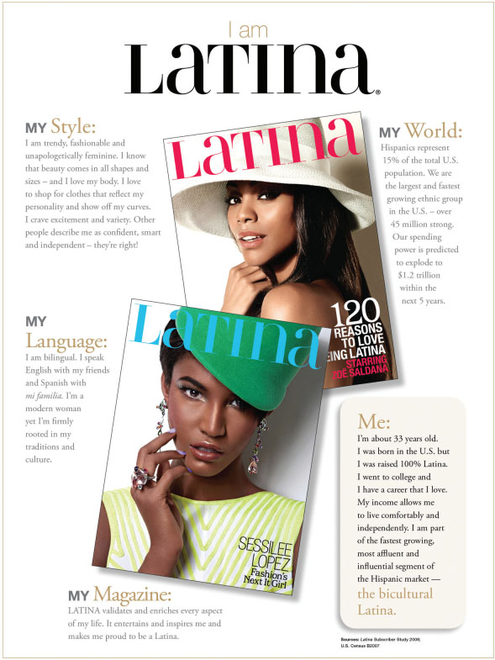
Hispanic Americans
“Hispanic” = many different backgrounds
Hispanics are:
Brand loyal
Highly concentrated geographically by country of origin (easy to reach)
Notes:
Hispanic is an umbrella term that describes people of many different backgrounds. About 60% are from Mexico with the next largest group (from Puerto Rico) making up less than 10%. The phrase Hispanic also captures Central Americans, Dominicans, South Americans, and Cubans. The segment is relatively easy to find with more than 50% living in the major metropolitan areas of Los Angeles, New York, Miami, San Antonio, San Francisco, and Chicago. However, among many Hispanics, there is a relatively low level of acculturation.

Slide 12
Distinguishing Characteristics of the Hispanic Market
Looking for spirituality, stronger family ties, and more color in their lives
Large family size of Hispanic market
Spend more on groceries
Shopping is a family affair
Regard clothing children well as matter of pride
Convenience/saving time is not important to Hispanic homemaker
Notes:
As this slide shows, Hispanic Americans differ substantially from Anglo consumers.

Slide 13
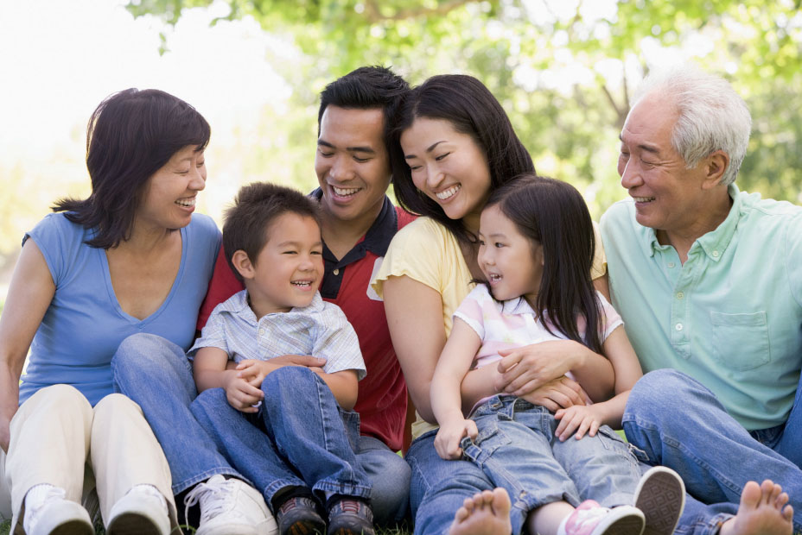
Asian Americans
Most affluent, best educated
Most brand-conscious but least brand loyal
Made up of culturally diverse subgroups that speak many different languages/dialects
Notes:
This slide reveals many of the distinguishing characteristics of Asian Americans. This group has a great deal of marketing potential but it is also difficult to target. This is because it is made up of many culturally diverse subgroups that use different languages and dialects. The term Asian refers to 20 ethnic groups.

Slide 14
For Reflection (1 of 9)
Identify some of the subcultures to which you belong. How do you identify with these subcultures?

Slide 15
For Reflection (2 of 9)
Though the “Big Three” are attractive segments for marketers to reach, why might they be difficult to approach?

Slide 16
For Reflection (3 of 9)
Identify products which have been deethnicized. How should these products be marketed now?
Notes:
As this slide shows, Hispanic Americans differ substantially from Anglo consumers.

Slide 17
Learning Objective 13.2
Our memberships in ethnic, racial, and religious subcultures often guide our consumption behaviors.
Notes:
The third section of this chapter focuses on subcultures related to ethnicity and race and religion.

Slide 18
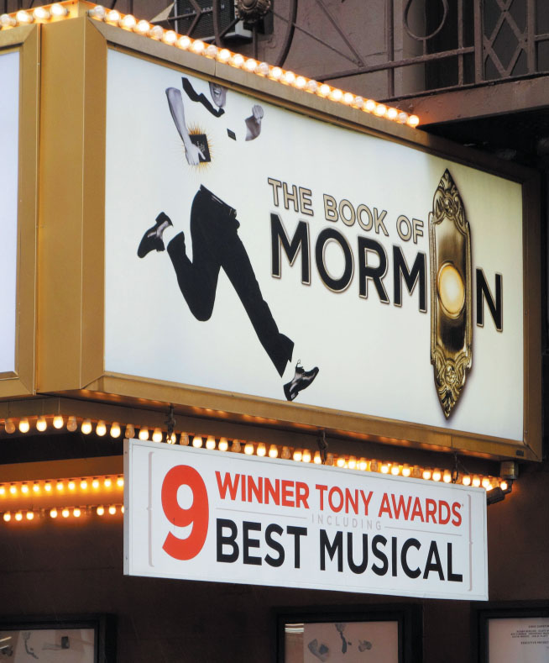
Religion and Consumption
Organized religion and product choices
Born-again consumers
Islamic marketing
Notes:
Religious subcultures have an impact on consumer variables such as personality, attitudes toward sexuality, birthrates and household formation, income, and political attitudes. Church leaders may encourage or discourage consumption of some products.
Even churches themselves are being marketed. For instance, megachurches actively market themselves to individuals who are born again and/or seeking a different sense of worship.
Importantly, muslims will be more than 25% of the Earth’s population by 2030. Marketing to muslims will require a special attentiveness to religious influences.

Slide 19
Ethnic and Racial Subcultures
An ethnic subculture is a self-perpetuating group of consumers who share common cultural or genetic ties where both its members and others recognize it as a distinct category.
In countries like Japan, ethnicity is synonymous with the dominant culture because most citizens claim the same cultural ties.
Notes:
Ethnicity matters when it comes to marketing, whether in a single country or for brands operating globally. For instance, McDonald’s has tailored its menu in different parts of the US and the world to meet the needs of ethnic subcultures.

Slide 20
For Reflection (4 of 9)
Think of an example of a product that is marketed based on religious consumption.

Slide 21
For Reflection (5 of 9)
Should members of a religious group adapt marketing techniques that manufacturers customarily use to increase market share for their products? Why or why not?

Slide 22
Learning Objective 13.3
Marketers increasingly use religious and spiritual themes when they talk to consumers.
Notes:
Marketers once avoided religious references but this is changing. Still, marketers have not extensively studied religious influences on consumer behavior.

Slide 23
The Family Unit and Age Subcultures
Family structure
Extended family
Nuclear family
Voluntarily childless
DINKS
Boomerang kids
Sandwich generation
Notes:
The extended family used to be the most common family unit. It consists of three generations who live together, and it often includes grandparents, aunts, uncles, and
cousins.
Like the Cleavers of Leave It to Beaver and other TV families of the 1950s, the nuclear family—a mother, a father, and one or more children (perhaps with a sheepdog
thrown in for good measure)—largely replaced the extended family, at least in U.S. society
The percentage of women of childbearing age who define themselves as voluntarily childless is on the rise.
So-called DINKS (double income, no kids) couples are better educated on average than are two-income couples with children.
Children are more likely to live at home after graduating from college rather than taking their own places, they are called boomerang kids- you throw them out and they keep coming back.
Some label middle-aged people the Sandwich Generation because they must support both the generation above them and the one below them.
The FLC combines trends in income and family composition with the changes these demands place on this income.

Slide 24
Family Life Cycle
Factors that determine how couples spend money:
Whether they have children
Whether both spouses work
Family life cycle (FLC) concept combines trends in income and family composition with change in demands placed on income.
Notes:
Many factors affect what a family spends, including the number of people in the family, their ages, and whether one, two, or more adults work outside the home. Two especially important factors that determine how a couple spends time and money are whether they have children and whether the woman works. The family life cycle concept enables marketers to segment households.

Slide 25
Variables Affecting FLC
Age
Marital Status
Children in the Home
Ages of Children in the Home
Notes:
Researchers over the years have proposed several models to describe family life cycle stages, but with limited effect because most failed to take into account trends like the changing role of women, childless and delayed-child marriages, alternative family styles, and single-parent households. Four variables are used to describe the changes a family undergoes: age, marital status, whether children are in the home, and the ages of children in the home. We also have to consider any couple as a household whether or not they are a traditional husband and wife.

Slide 26
For Reflection (6 of 9)
For the following products, discuss how having children or not might affect the choices a couple makes. What do such variations mean for marketers?
Groceries
Cars
Vacations

Slide 27
Learning Objective 13.5
We have many things in common with others because they are about the same age.
Notes:
Our age is a big part of our identity. We are more likely to have things in common with people close to our age. An age cohort consists of people of similar ages who have similar experiences. They share many common memories about cultural heroes, important historical events, and so on.

Slide 28
Generational Categories
The Interbellum Generation
The Silent Generation
The War Baby Generation
The Baby Boom Generation
Generation X
Generation Y
Generation Z
Notes:
Although there is a general consensus on how analysts describe age cohorts, the exact labels and cutoff dates do vary. These are some approximations for the primary categories.
The Interbellum generation describes those who are born at the beginning of the 20th century. The Silent Generation describes those who were born between the two World Wars. The War Baby Generation was born during World War II. The Baby Boom Generation was born between 1946 and 1964. Generation X was born between 1965 and 1985. Generation Y was born between 1986 and 2002. Generation Z was born 2003 and later.

Slide 29
Gen Y and Z
Four basic conflicts are common among all teens:
Autonomy versus belonging
Rebellion versus conformity
Idealism versus pragmatism
Narcissism versus intimacy
Notes:
Teenagers in every culture grapple with fundamental developmental issues when they transition from childhood to adult. Throughout history young people have coped with insecurity, parental authority, and peer pressure. The Saatchi & Saatchi advertising agency identified four basic conflicts common to all teens. These are listed on the slide and described here.
Autonomy versus belonging means that teens want to acquire independence so they try to break away from their families. But at the same time, they want to attach themselves to a support structure. Rebellion versus conformity grasps that teens need to rebel against social standards of appearance and behavior but they need to fit in and be accepted by others. Idealism versus pragmatism means that they tend to view adults as hypocrites whereas they see themselves as sincere. Narcissism versus intimacy means that they tend to obsess about their appearance and needs. However, they also feel the desire to connect with each other.

Slide 30
Getting to Know Gen Z
Born in the late 1990’s to early 2000’s
Most diverse generation
Digital natives

Slide 31
Getting to Know Gen Y
“Echo Boomers” = “millennials” = Gen Yers
Make up one-third of U.S. population
Spend $170 billion a year
First to grow up with computers in their homes, in a 500-channel TV universe
Notes:
Generation Y also goes by the labels of Millennials and Echo Boomers. They were born between 1984 and 2002. They may grow up in nontraditional families. Members of Gen Y are jugglers who value being footloose and connected to their “peeps.” Saatchi & Saatchi label this new kind of lifestyle ‘connexity.’
These Millennials are the first generation to grow up with computers at home. They are multitaskers. They truly are digital natives. They use texting and video and create user-generated content.

Slide 32
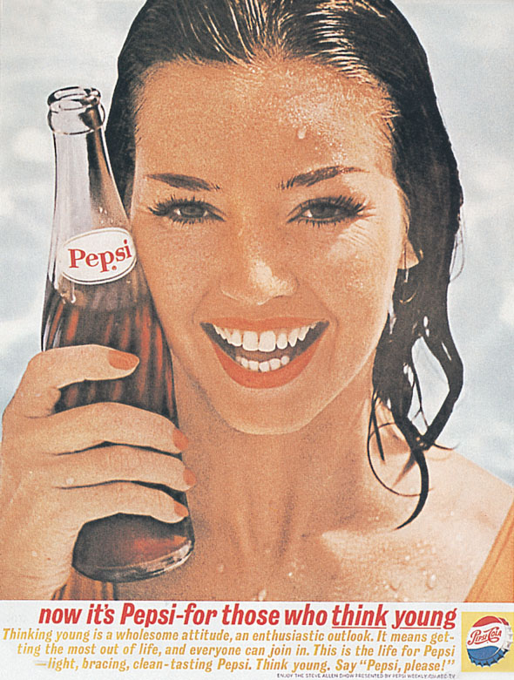
Learning Objective 13.6
Teens are an important age segment for marketers.
Notes:
The global youth market is massive. It represents about $100 billion in spending power.

Slide 33
Generation X
Consumers born between 1966 and 1976
Today’s Gen Xer is both values-oriented and value-oriented
Desire stable families, save portion of income, and view home as expression of individuality
Notes:
Generation X got a bad reputation unfairly. Originally they were called slackers and baby busters, but since they’ve grown up, they have been responsible for many culture-changing products like Google, YouTube, and Amazon.

Slide 34
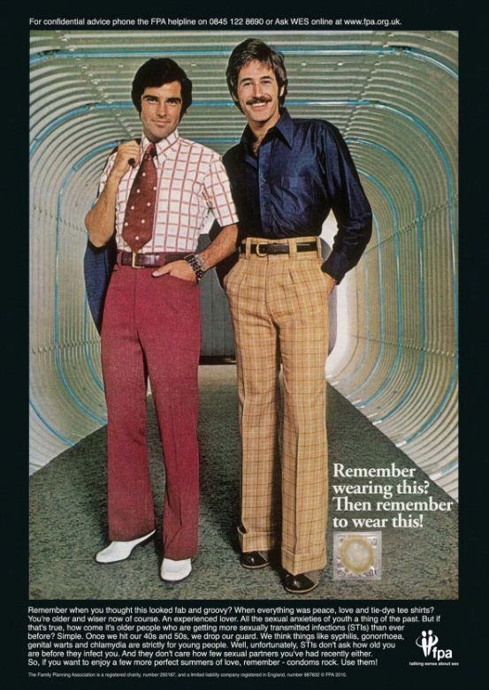
Learning Objective 13.7
Baby boomers continue to be the most powerful age segment economically.

Slide 35
Baby Boomers
Consumers born between 1946 and 1965
Active and physically fit
Currently in peak earning years
Food, apparel, and retirement programs
“Midlife crisis” products
Notes:
The baby boomer cohort consists of people whose parents established families following the end of World War II and during the 1950s when the peacetime economy was strong and stable. In addition to the direct demand for products and services this group creates, these consumers have also fostered a new baby boom of their own to keep marketers busy in the future. Because it wasn’t as big as the first, we call it a baby boomlet.

Slide 36
For Reflection (7 of 9)
What will happen to the markets for products like Restylane as the Baby Boomers continue to age?

Slide 37
Learning Objective 13.8
Seniors continue to increase in importance as a market segment.
Notes:
The United Nations says that people older than 60 are the fastest-growing age group on earth. We call this group the gray market. Older adults control more than 50% of discretionary income.

Slide 38
Perceived Age: You’re Only as Old as You Feel
Age is more a state of mind than of body
Perceived age: how old a person feels as opposed to his or her chronological age
“Feel-age”
“Look-age”
The older we get, the younger we feel relative to actual age
Notes:
Perceived age is how old a person feels and is a better yardstick of age than how old a person is biologically. Researchers measure age by feel-age (how old one feels) and look-age (how old a person looks). Marketers may need to emphasize product benefits rather than age-appropriateness in marketing campaigns for older adults because the older we get, the younger we feel relative to our actual age.

Slide 39
Values of Older Adults
Autonomy: want to be self-sufficient
Connectedness: value bonds with friends and family
Altruism: want to give something back to the world
Notes:
It is important for marketers to understand the psyche of older people. Researchers point to a set of key values relevant to mature consumers. These include autonomy, connectedness, and altruism.

Slide 40
For Reflection (8 of 9)
Is it practical to assume that people 60 and over constitute one large consumer market (i.e., the gray market)? How can marketers segment this age subculture?

Slide 41
Learning Objective 13.9
Birds of a feather flock together in place-based subcultures.
Table 13.1 A Comparison of Two Different Youth-Oriented PRIZM Clusters
Segment #4: Young Digerati | Segment #24: Up-and-Comers
Tech-savvy consumers who live in trendy urban neighborhoods filled with fitness clubs, boutiques, and microbreweries. | A transition segment for young, middle-class singles before they marry and establish families. Primarily live in mid-size cities and includes many recent college graduates who are into athletic activities, technology, and nightlife.
Much more likely than the average consumer to: Shop at Bloomingdale’s Travel to Asia Read Dwell Watch Independent Film Channel Drive an Audi A3 | Much more likely than the average consumer to: Order from Priceline.com Travel to South America Read Cigar Aficionado Watch South Park Drive a Nissan Altima Hybrid
Adapted from “My Best Segments,” Nielsen, http://www.claritas.com/MyBestSegments/Default.jsp?ID=30&pageName=Segment%2Bexplorer, accessed April 21, 2015.
Notes:
This age-old saying is the perfect motto for place-based subcultures. A place-based subculture means that people tend to be like those who live in the same areas, types of homes, and types of neighborhoods. They share common consumption patterns and common socio-economic characteristics. Marketers use systems like Nielsen’s PRIZM to identify the clusters of people who are also grouped by zipcode.

Slide 42
For Reflection (9 of 9)
If you were a marketing researcher assigned to study what products are “cool,” how would you do this?
How has the definition of what is cool changed as the generations have aged?

Slide 43
Chapter Summary (1 of 2)
If you were a marketing researcher assigned to study what products are “cool,” how would you do this?
How has the definition of what is cool changed as the generations have aged?
Notes:
We’ve reviewed many concepts in this chapter. The key points are noted on this slide and the next.

Slide 44
Chapter Summary (2 of 2)
People tend to have things in common with others about their same age.
Teens, tweens, baby boomers, and seniors are all important markets.
Even place can play a role in our consumer identity.

Slide 45

Copyright

